Slide 1
Welcome the the experiment. Press the space bar to advance to the next slide.

Slide 2
Training block 1

Slide 3
This is the discs task.
On each trial, the first thing that you are going to see is a fixation cross (like this: +).
It is important that you look at the cross, because it will quickly be replaced with a number (from 0 to 3).
After seeing the number, you will look inside of a room that will have either 0, 1, 2, or 3 red discs hanging on the walls.
If the number of discs on the walls matches the number you have just seen, press 'b' (for YES).
If the number of discs on the wall does NOT match the number you have just seen press 'n' (for NO).

Slide 4
Before we start, here is some practice.
On the next screen, you will see the cross (+), the number ‘0’, and then you will see a room with 0 discs hanging on the wall.
Because the number of discs matches the number, you should press ‘b’ (for YES).
Press the space bar to walk through this process.

Slide 5
+

Slide 6
0

Slide 8
NICE!
In the next example, you will see the cross, the number ‘3’, and then a room with two discs on the wall.
In this trial, you would press ‘n’ for NO, because the number of discs does NOT match the numeral you saw.
Press the space bar to walk through this process.

Slide 9
+

Slide 10
3

Slide 11
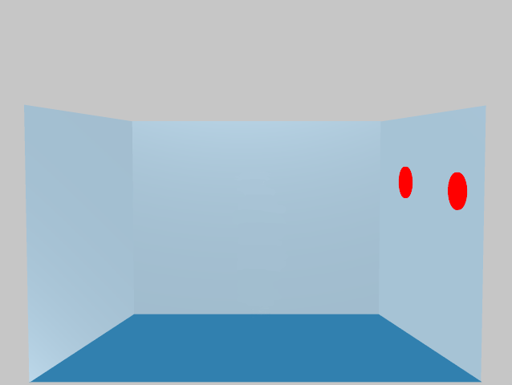

Slide 12
Later on, you will be doing this on your own and for a longer period of time.
You will have 2 seconds to give a yes or no answer on each trial, so please respond as quickly and as accurately as you can.
Let’s do a little more practice before you begin.
Press the spacebar to start.

Slide 13
+

Slide 14
1

Slide 15
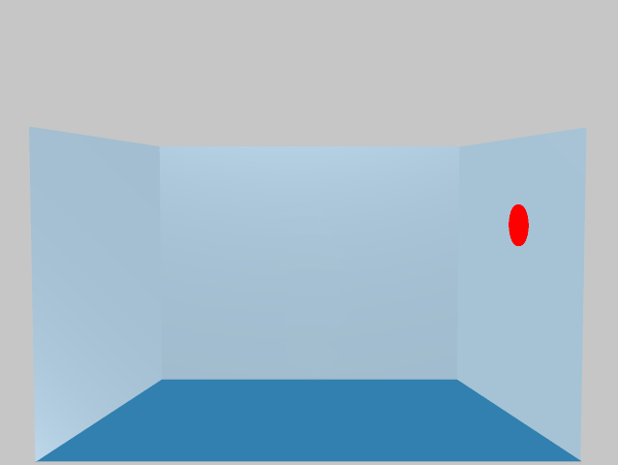

Slide 16
+

Slide 17
2

Slide 19
+

Slide 20
3

Slide 21
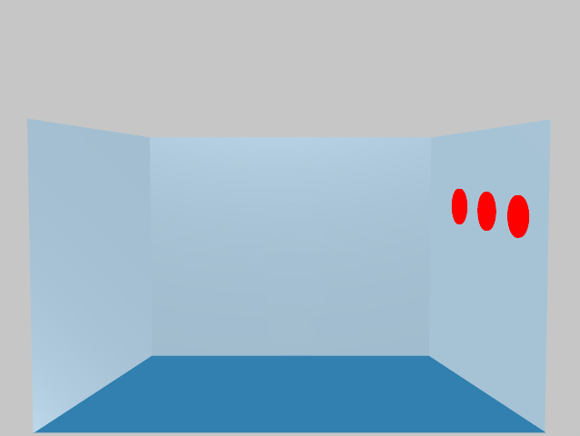

Slide 22
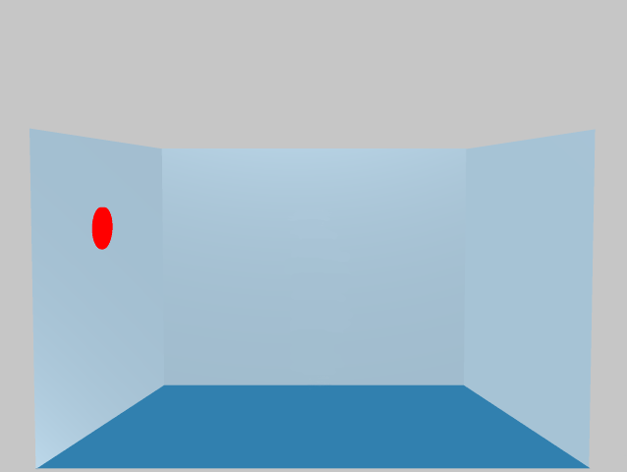

Slide 23
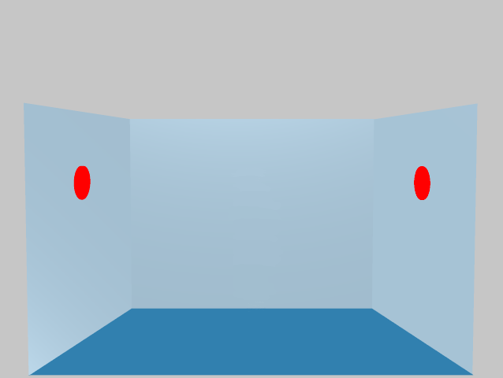

Slide 24
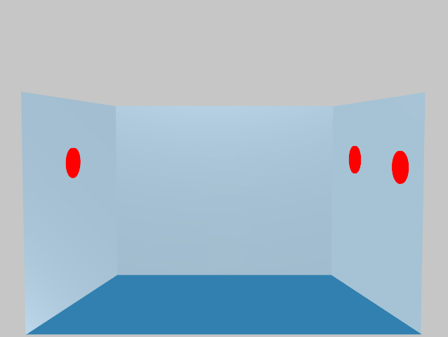

Slide 25
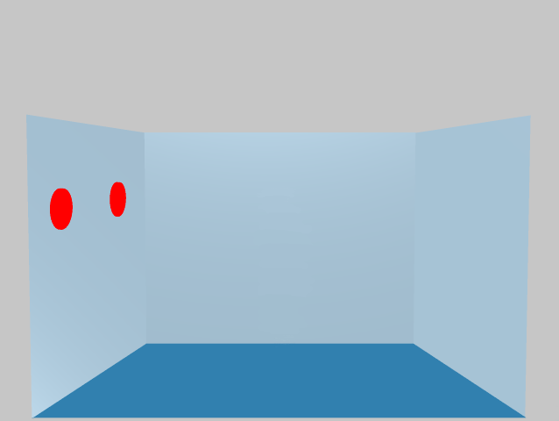

Slide 26
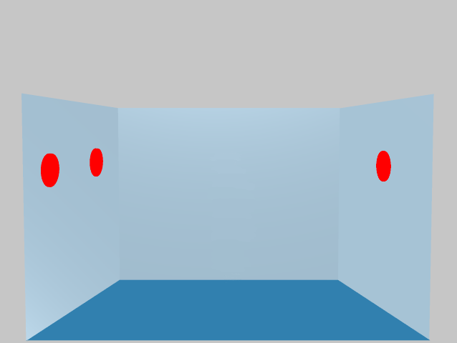

Slide 27
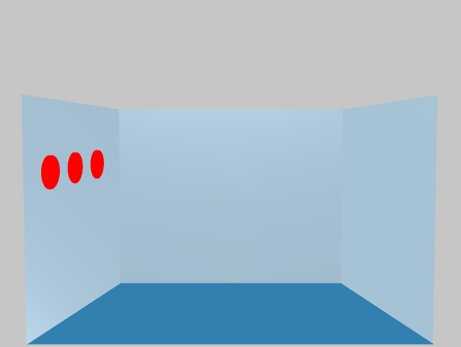

Slide 28
Familiarization part 1: interactive encounter

Slide 29
Okay, your first practice is over. You will get another chance to practice later on.
Before you do the task on your own, you will view a few more slides.
Press the spacebar to continue.

Slide 30
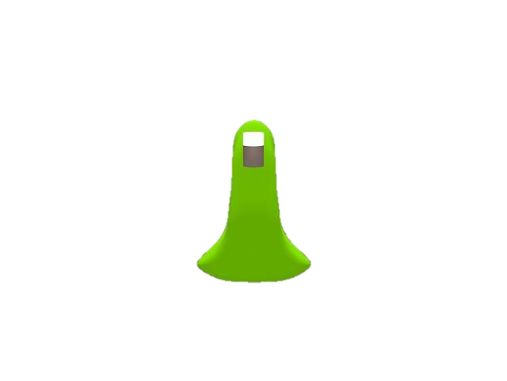
Greetings, Human! My name is Dax. I am from the planet Zuorota.
Notes:
Participants could click through the slides, or we could automate them

Slide 31
I am part of a race of creatures called Blickets. We Blickets live in caves, and feed on the fungi and bacteria that grow there.

Slide 32
Blickets have a single, large white eye that allows us to see in the dark as we forage for fungus in our caves.

Slide 33
For most of our lives, we live in solitude. We spend our days wandering the caves of the planet Zuorota, searching for other Blickets to keep us company.

Slide 34
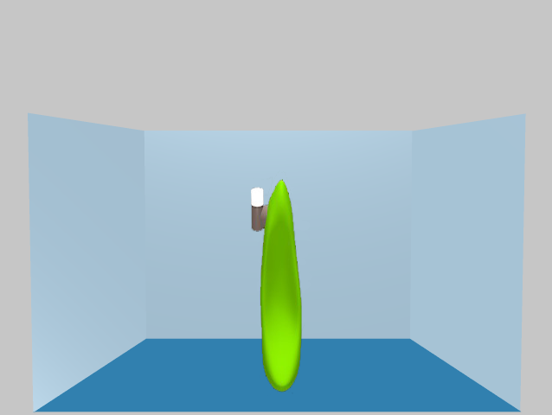
Hello? Is anyone there?

Slide 35
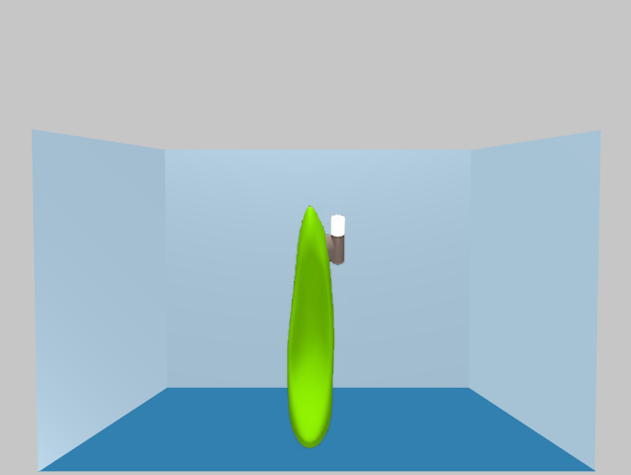
Anybody?

Slide 36
Sigh...

Slide 37
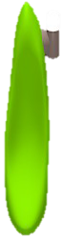
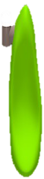
When we do meet one another, we often fall in love at first sight.

Slide 38
We Blickets are very romantic beings, you know!

Slide 39
“Has anyone ever told you that you have the most beautiful eye?”

Slide 40
“Why, I was about to say the same thing about your eye!”

Slide 42
When we do fall in love, we often pair for life.

Slide 43
I haven’t met my one true love yet. I’m very lonely...

Slide 44
But enough about me! Let me tell you more about Blickets.

Slide 45
We Blickets are slow and clumsy, and we live in constant fear of predators.

Slide 46
But we do have one trick to avoid predators...

Slide 47
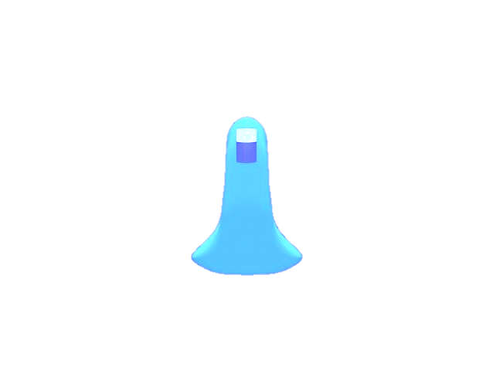
We happen to look just like blue andradite, a highly radioactive mineral that grows everywhere on the planet Zuorota.

Slide 48
See? The resemblance is uncanny!

Slide 49
Predators can’t tell us apart from the blue andradite because they’re color-blind.

Slide 50
When they are nearby, we just stand still and pretend that we’re minerals, and they leave us alone.

Slide 51
Pretty cool, right?

Slide 52
Familiarization part 2: agent/mineral contrast task

Slide 53
Now we can play a game! Let’s see if you can tell me apart from the mineral.
Notes:
Participants could click through the slides, or we could automate them

Slide 54
Press the space bar when you see me, but not when you see the mineral.
Notes:
Participants could click through the slides, or we could automate them

Slide 55
Ready? Go!
Notes:
Participants could click through the slides, or we could automate them

Slide 56
Notes:
Randomize the following 6 images, loop 3 times.

Slide 57
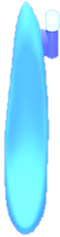

Slide 58
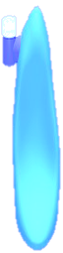

Slide 62
Nice work! Now let’s do it the other way: press [KEY] when you see the mineral, but not when you see me.
Notes:
Participants could click through the slides, or we could automate them

Slide 63
Notes:
Randomize the following 6 images, loop 3 times.

Slide 69
Good job!
Notes:
Participants could click through the slides, or we could automate them

Slide 70
Now you will complete a different version of the discs task.
On each trial, you will first see a fixation cross (+).
It is important that you look at the cross, because it will quickly be replaced by either the word ‘YOU’ or the word ‘DAX’.
Then the word will be replaced by a number from 0 to 3.
Next, an image of a room with 0, 1, 2, or 3 red disks on the walls. You will also see Dax in the middle of the room.

Slide 71
On half of the trials, you must check if the number corresponds to how many discs you can see from your perspective.
On the other half of the trials, you must check if the number corresponds to how many discs Dax can see from Dax’s perspective.

Slide 72
When you first see the word ‘YOU’, you must check whether the number of discs on the walls that you can see matches the number just displayed on the screen.
When you first see the word ‘DAX’, you must check whether the number of discs on the walls that Dax can see matches the number just displayed on the screen.
Press ‘b’ for YES and ‘n’ for NO.

Slide 73
For example, on the next slide, you will first see the word ‘YOU’, and then the number ‘0’. Then you will see a room with 0 discs.
In this trial, you would press ‘b’ for YES, because the number matches the number of discs that you can see.

Slide 74
+

Slide 75
YOU

Slide 76
0

Slide 77
TEST TRIALS BEGIN

Slide 78
On the next slide, you will first see the word YOU, and then the number ‘3’. Then you will see a room with 2 discs.
In this trial, you would press ‘n’ for NO, because the number does not match the number of discs that you can see.

Slide 79
+

Slide 80
YOU

Slide 81
3

Slide 82
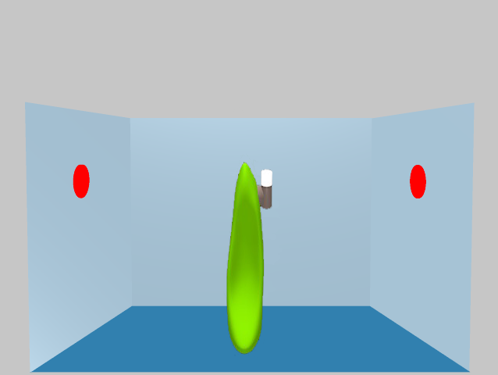

Slide 83
On the next slide, you will first see the word DAX, and then the number ‘2’. Then you will see a room with 2 discs that Dax can see.
In this trial, you would press ‘b’ for YES, because the number matches the number of discs that Dax can see.

Slide 84
+

Slide 85
DAX

Slide 86
2

Slide 87
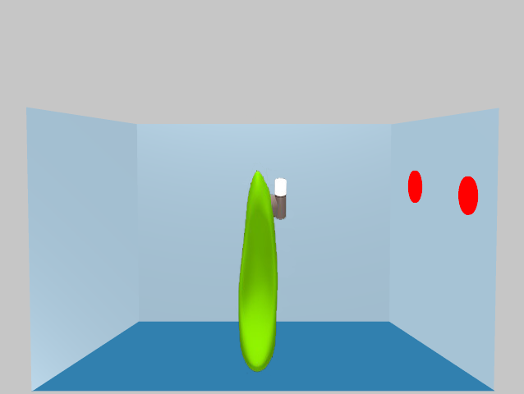

Slide 88
On the next slide, you will first see the word ‘DAX’, and then the number ‘3’. Then you will see a room with 3 discs that Dax cannot see.
In this trial, you would press ‘n’ for NO, because the number does not match the number of discs that Dax can see.

Slide 89
+

Slide 90
DAX

Slide 91
3

Slide 92
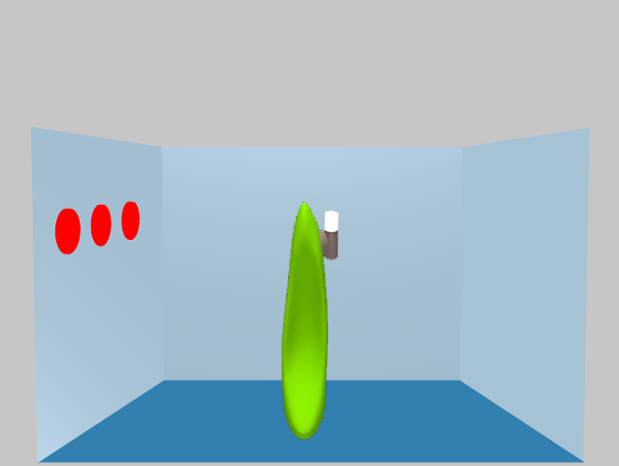

Slide 93
Now let’s start with a practice block consisting of 26 trials.
For each trial, you have a maximum of 2 seconds to respond. Please try to be as quick as possible while making as few mistakes as possible.
Then there will be 4 test blocks. Between the blocks, you can take a break.
Thanks again for your participation!
Press the spacebar to start.

Slide 94
TEST TRIALS BEGIN

Slide 95
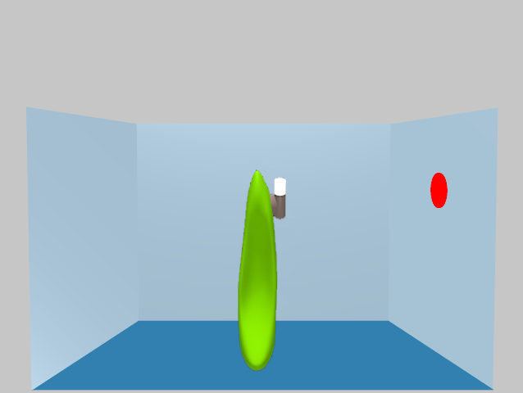

Slide 97
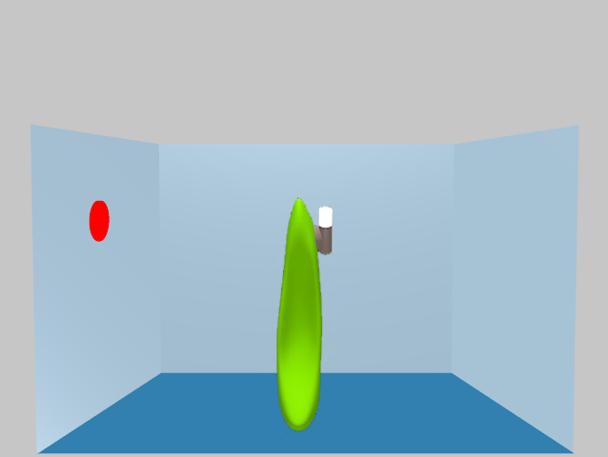

Slide 99
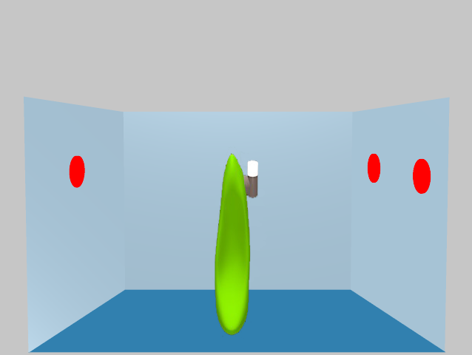

Slide 100
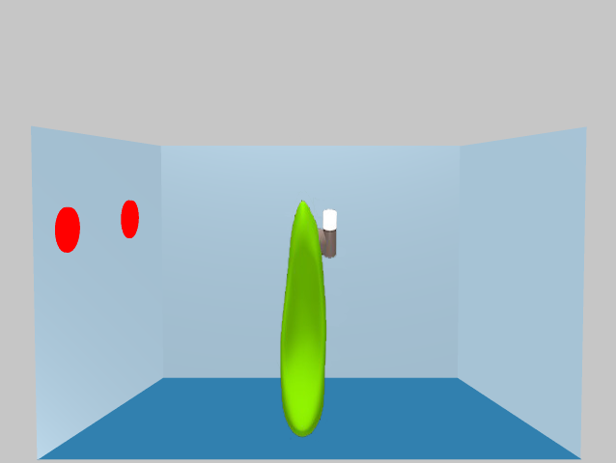

Slide 101
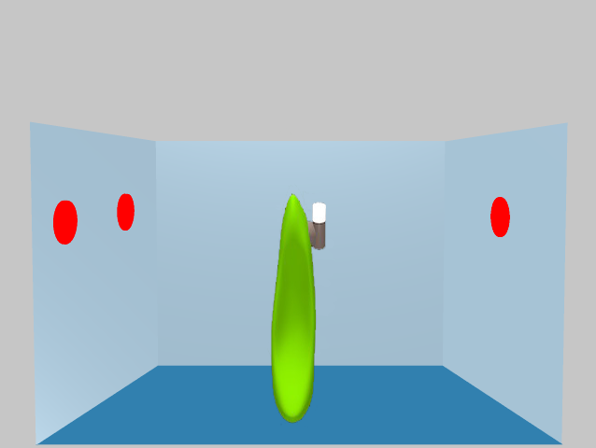

Slide 104
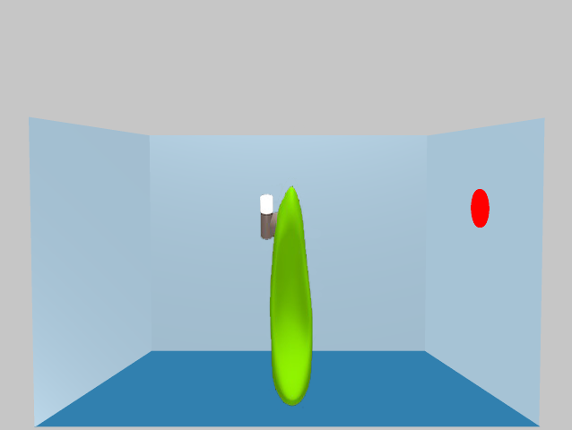

Slide 105
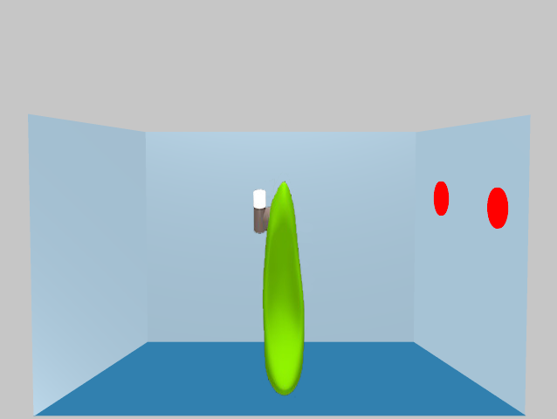

Slide 106
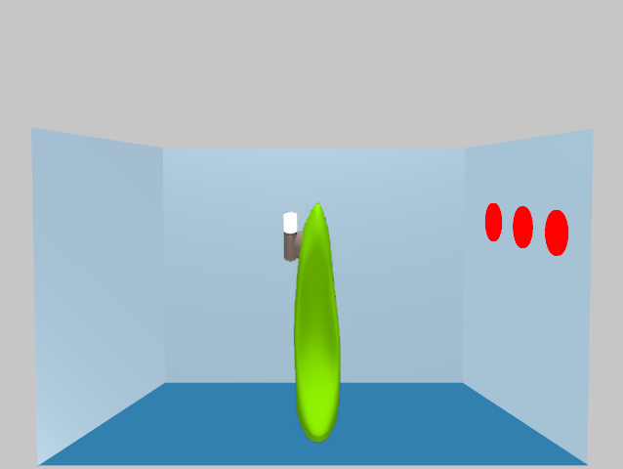

Slide 107
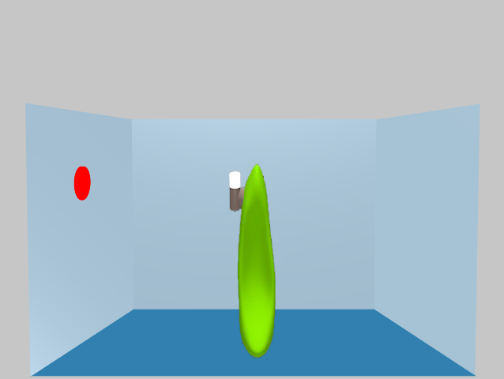

Slide 108
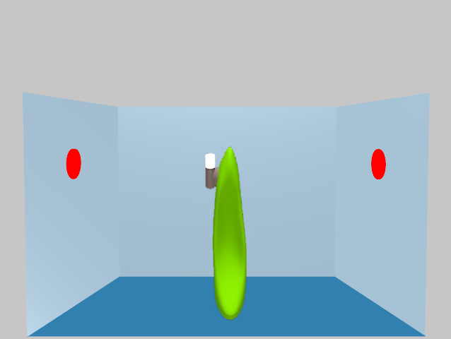

Slide 109
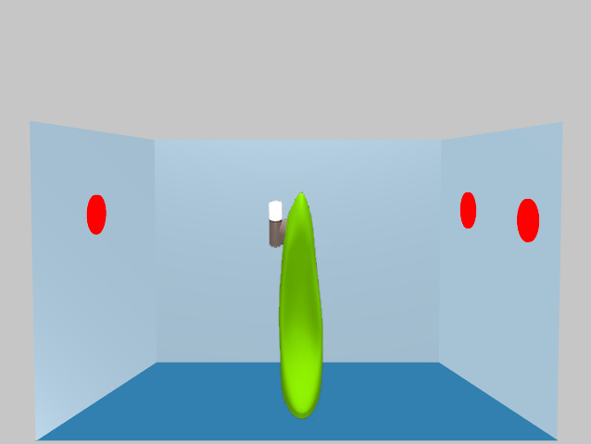

Slide 110
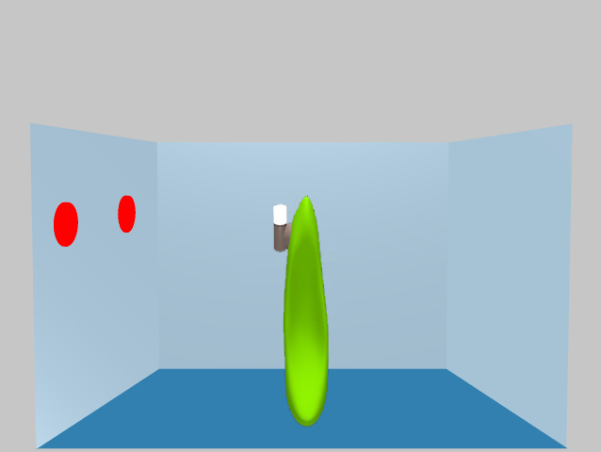

Slide 111
